Slide 1
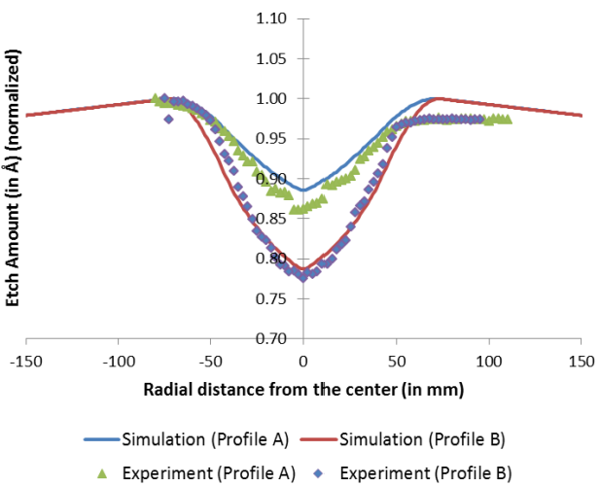
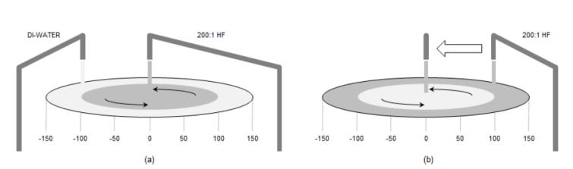
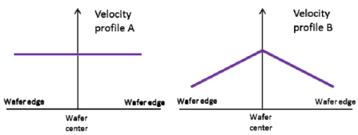
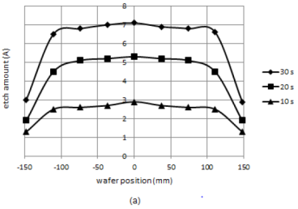

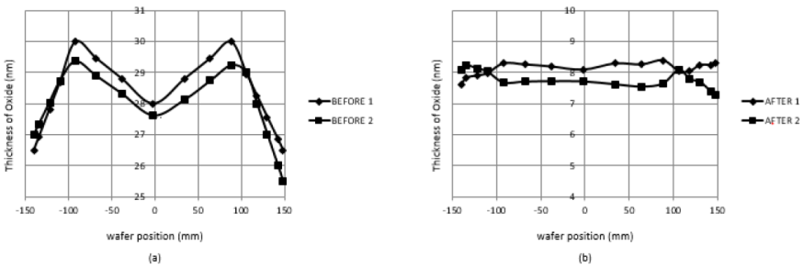


※Improvement in wet etch process to control the in-wafer etch amount by utilizing DI-water dilution and controlled etchant arm movement.
Active profile is becoming smaller, needs more constricted thermal oxide thickness, there will be more stringent requirements for uniformity.
By optimizing the wet etch process, the radial distribution shape of Etch Rate on Wafer is changed similar as that of Thickness, and the uniformity of Thermal oxide will improved by WET Etch
The edge Etch rate is reduced by DIW-dilute method.
Nozzle Swing is applied to reduce the Chemical Exposure Time of central area and reduce the etch rate
a. Edge DIW-dilute
b. Nozzle Swing
Wet
Etch
M – (∩ + V) = –
By a & b
Create “∩” shape Etch Rate
Create “V” shape Etch Rate
Notes:
References:
Effect of DI-water dilution and etchant arm movement on spinning type wet etch.
An Empirical Approach to Accurate Single Wafer Wet Etch Simulation.
Numerical Calculation Model of Single Wafer Wet Etcher Using Swinging Nozzle.

